Slide 1
Problem Identification
The Resort has recently installed an additional chair lift to help increase the distribution of visitors across the mountain. This additional chair increases operating costs by $1,540,000 this season. The company needs to know how to quantitatively justify a price increase of 5-10%
The Resort has valuable assets: 11 lifts, 2 T-bars, and 1 magic carpet for novice skiers. The longest run is named Hellfire and is 3.3 miles in length. The base elevation is 4,464 ft, and the summit is 6,817 ft with a vertical drop of 2,353 ft.
These assets represent a better value on average than competitor’s assets

Slide 2
Recommendations and key findings
Scenario 1 : Close up to 10 of the least used runs. The number of runs is the only parameter varying.
Closing one run makes no difference. Closing 2 and 3 successively reduces support for ticket price. Closing 3 runs, is the same closing 4 or 5 as there's no further loss in ticket price. Increasing the closures down to 6 or more leads to a large drop.
Scenario 2 : Big Mountain adds a run, and increases the vertical drop by 150 feet, and installs an additional chair lift. Recommended Option.
This scenario increases support for ticket price by $1.99. Over the season, this could be expected to amount to $3474638

Slide 3
Recommendations and key findings
Scenario 3 : Repeat the previous step but add 2 acres of snow making
This scenario increases support for ticket price by $1.99. Over the season, this could be expected to amount to $3474638. There are no changes from the previous scenario
Scenario 4 : Increase longest run by 0.2 miles and guarantee snow coverage by adding 4 acres of snow making capability
This scenario shows no difference

Slide 4
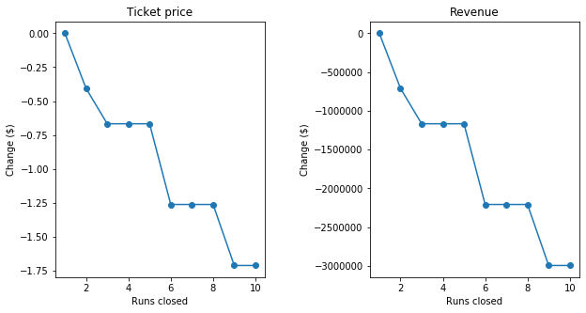
Modeling results and analysis : closing runs

Slide 5
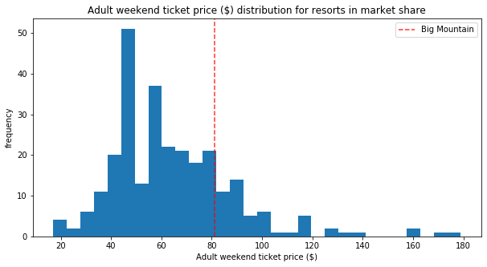
Modeling results and analysis: ticket price market comparison

Slide 6
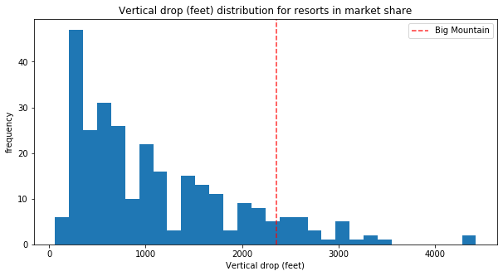
Modeling results and analysis : vertical drop market comparison

Slide 7
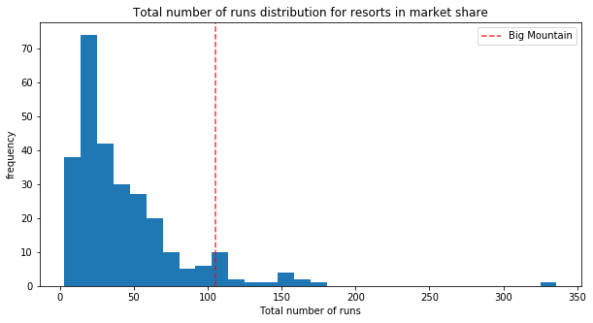
Modeling results and analysis : Number of runs market comparison

Slide 8
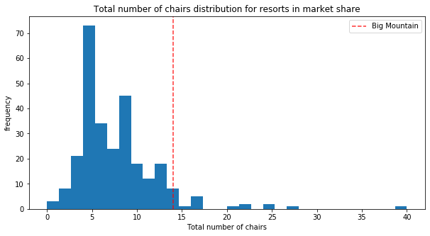
Modeling results and analysis : Number of chairs market comparison

Slide 9
Summary
The model (random forest regressor) predicted Big Mountain's ticket price to be 94.22 dollars, actual price is 81.00 dollars.
The distribution of market ticket prices shows an opportunity for increasing the price, especially considering the value that Big Mountain offers in terms of these features compared to other resorts
Assuming visitors on average buy 5-day tickets, the data shows that scenario 2 is a solid option, Big Mountain adds a run, increases the vertical drop by 150 feet, and installs an additional chair lift without the additional costs in the other scenarios, adding 1.99 dollars to the ticket price, which over the season could be expected to amount to 3474638 dollars.
This option could potentially cover the additional engineering and operational costs (we know the chair lift is 1,540,000 dollars, the team would need to provide the additional pricing information)

